Slide 1
SMART HEALTH MONITORING SYSTEM
Group 8 presents,
Presented by:
Shruthi V. Nair, 101633
Nimmy Augustine, 101634
Leo Varghese, 101530

Slide 2

ROADMAP
PROBLEM STATEMENT
EXISTING SYSTEM
PROPOSED SYSTEM
DESIGN
S/W AND H/W REQUIREMENTS
IMPLEMENTATION
CONCLUSION
REFERENCES

Slide 3
1.
PROBLEM STATEMENT
What is our project all about?

Slide 4
Our system is designed to get the data from the health monitoring sensors connected to the patient and make it available to the concerned Doctor.

Slide 5

A graphical representation of what our system intends to do

Slide 6
WHY?
Ease of accessing patient’s data
Remote monitoring of patient’s health
Instant support for the patient

Slide 7
2.
EXISTING SYSTEM

Slide 8
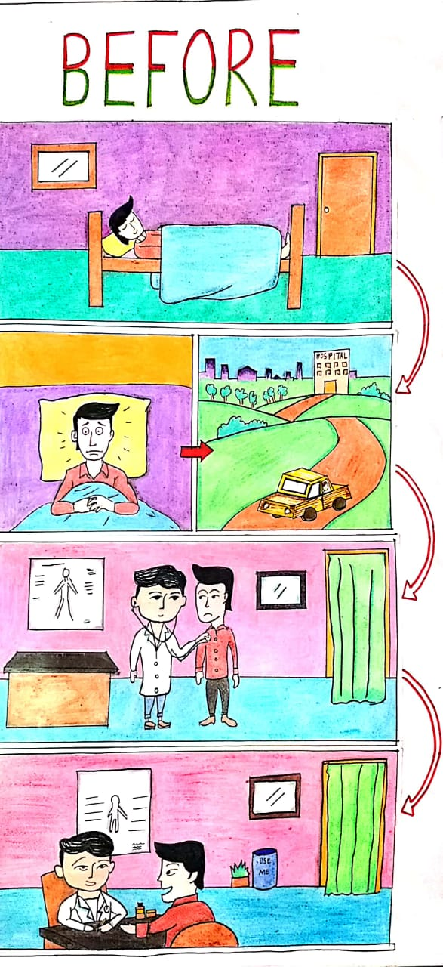

Slide 9
EXISTING SYSTEMS
Wireless Health Monitoring System for Patients (No storing of real time data safely and securely)
Patient Health Monitoring System Based on Internet of Things (Security concerns)
Smart health monitoring system of patient through IoT (No centralized security issues solved)
Internet of things (IoT) based smart health care system (No Security)

Slide 10
3.
PROPOSED SYSTEM
Our solution to the problem

Slide 11
PROPOSED SYSTEM
Our proposed system uses sensors to track patient’s health and uses internet to inform their respective doctor or family members in case of any emergency. As per tracked by the system, the doctor can take the required action.

Slide 12
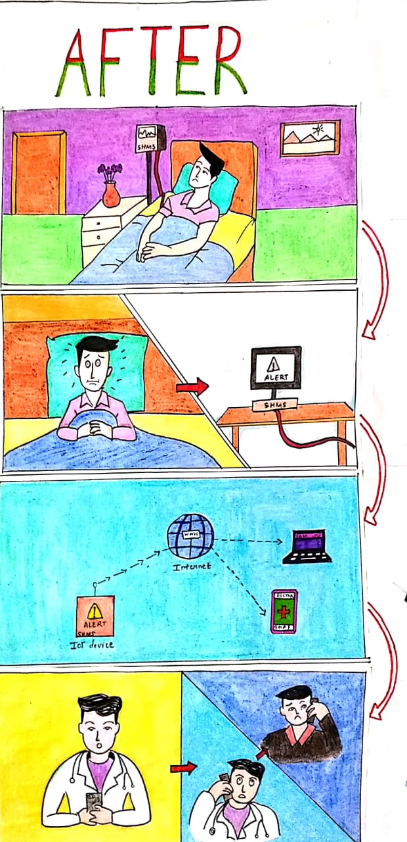

Slide 13
4.
DESIGN

Slide 14
Esp8266
NodeMCU
Data monitored
Pulse Sensor
Firebase
(For storage)
Received by the
Doctor/
Patient’s family member
Alert message in case of emergency
Temperature Sensor
Blockchain
(For storage of patient health data)
Block Diagram of the System

Slide 15
5.
HARDWARE & SOFTWARE REQUIREMENTS

Slide 16
Hardware Requirements
LM35
Pulse Sensor
Esp8266 NodeMCU
Breadboard
Jumper Wires

Slide 17
Software Requirements
Arduino IDE
Firebase
Solidity

Slide 18
6.
IMPLEMENTATION

Slide 19
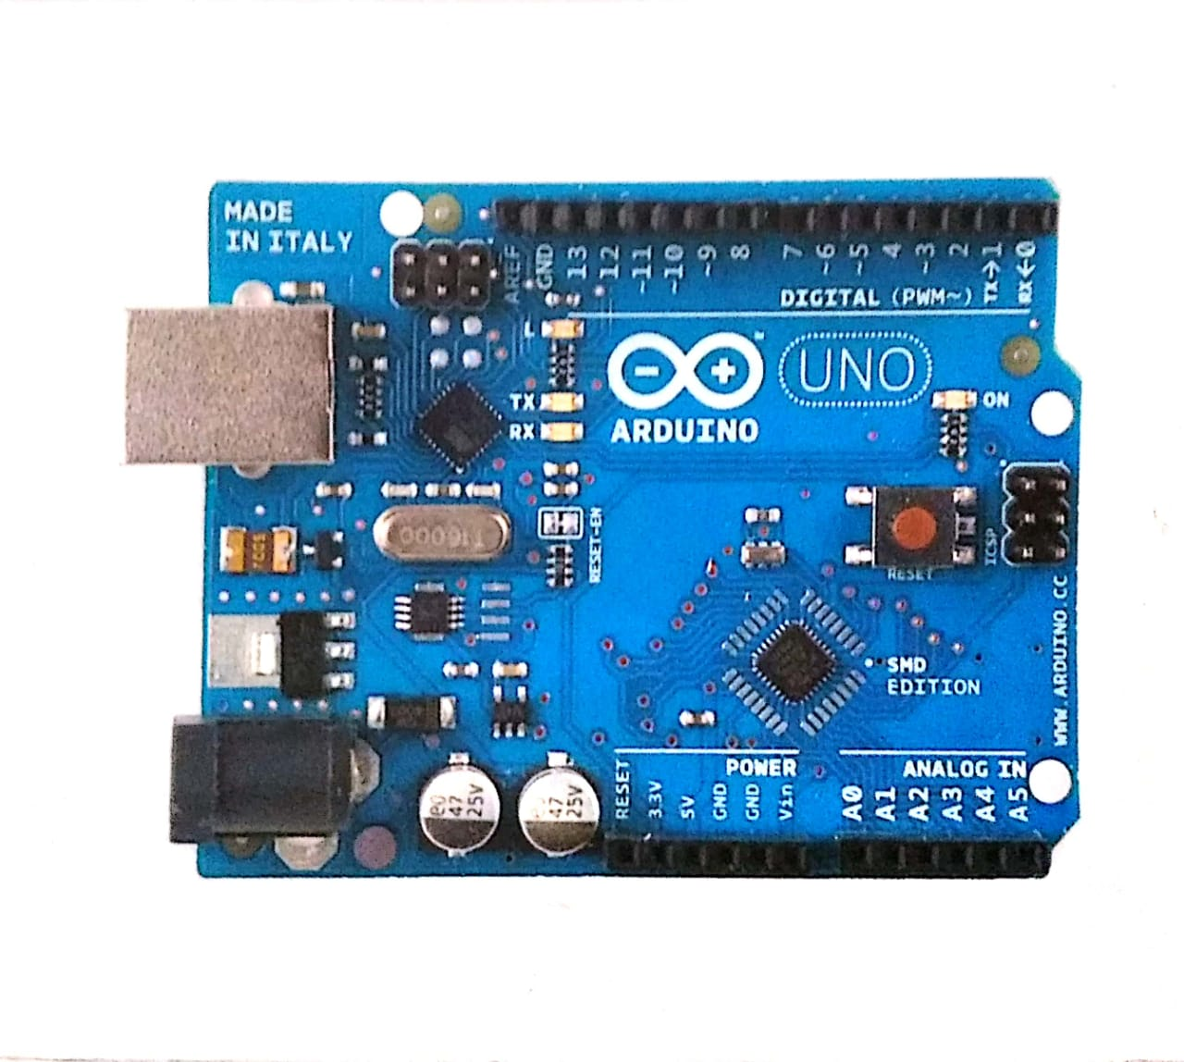

Slide 20
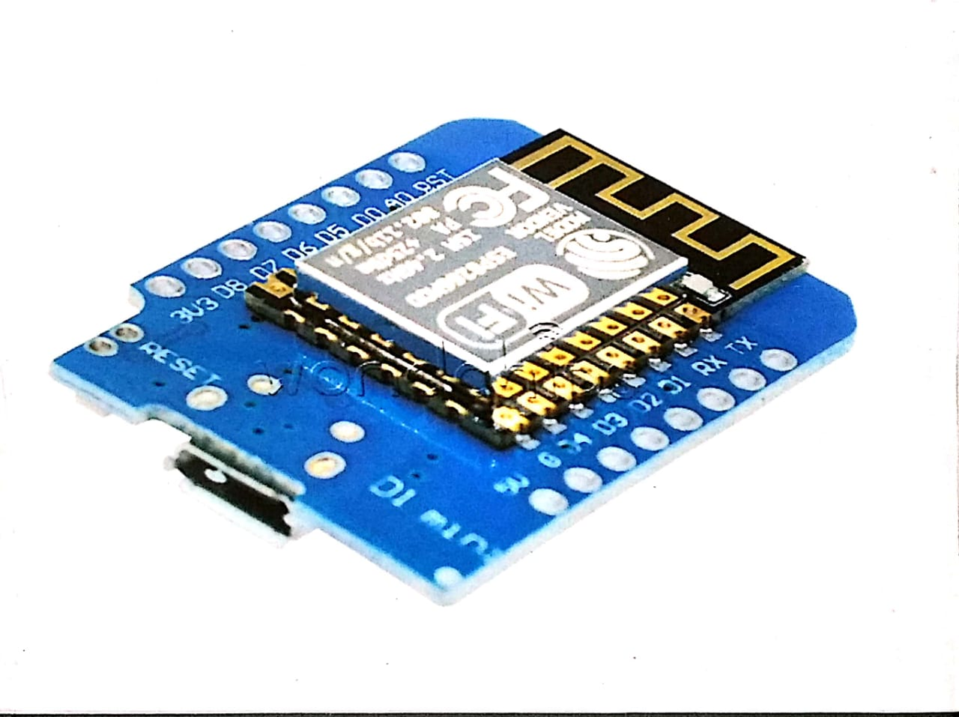

Slide 21
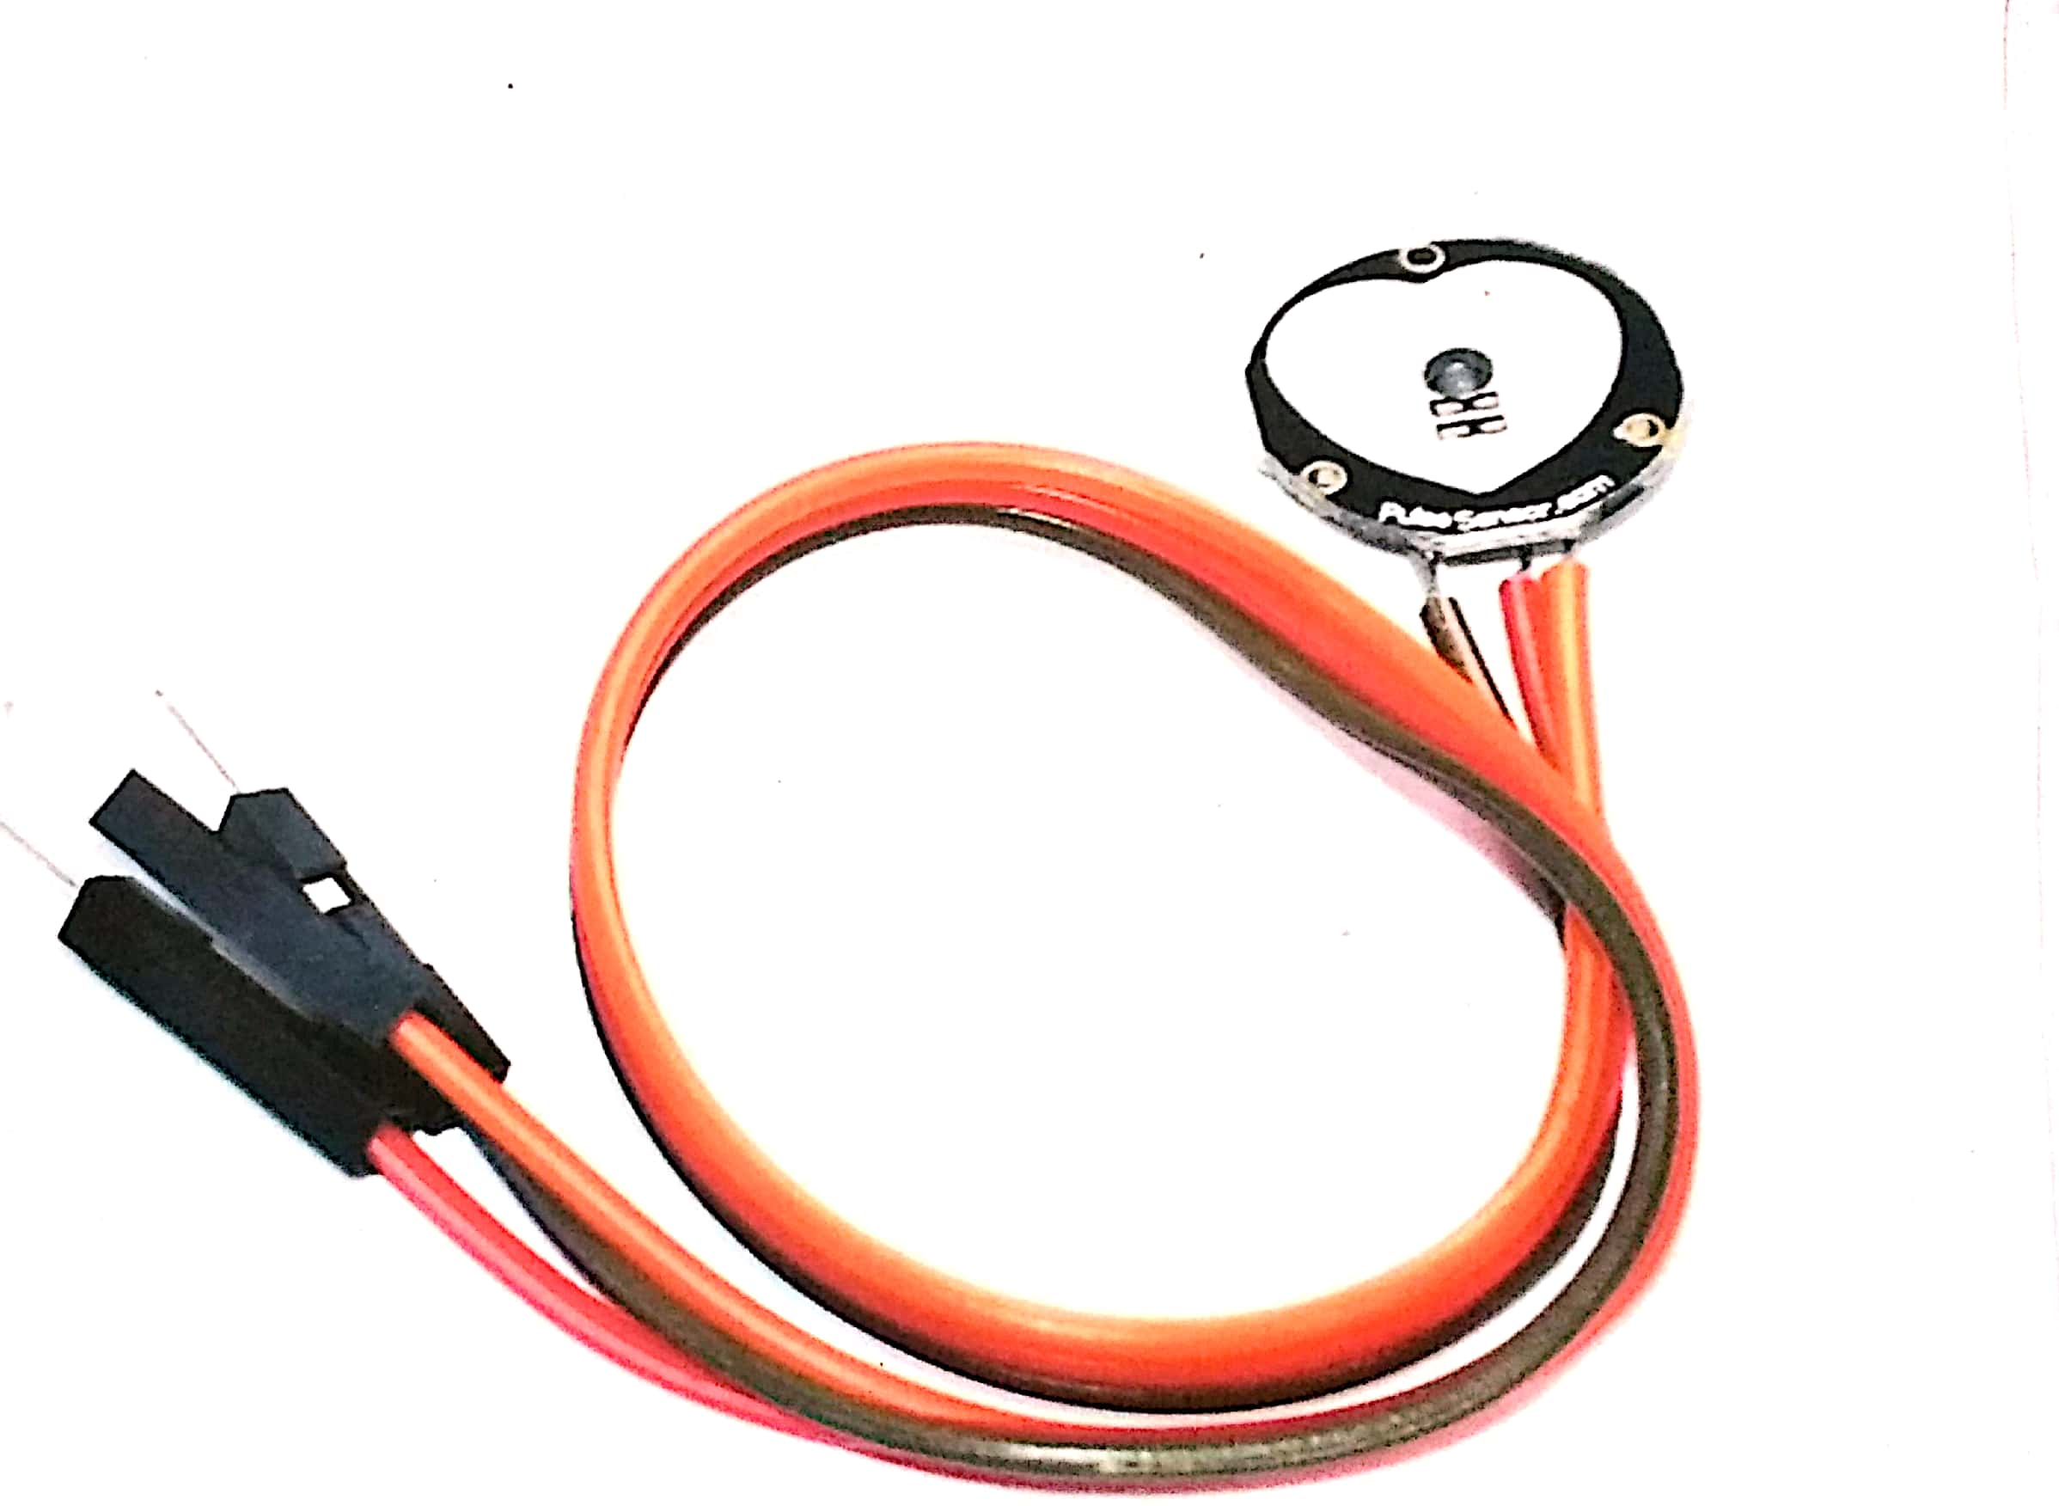

Slide 22
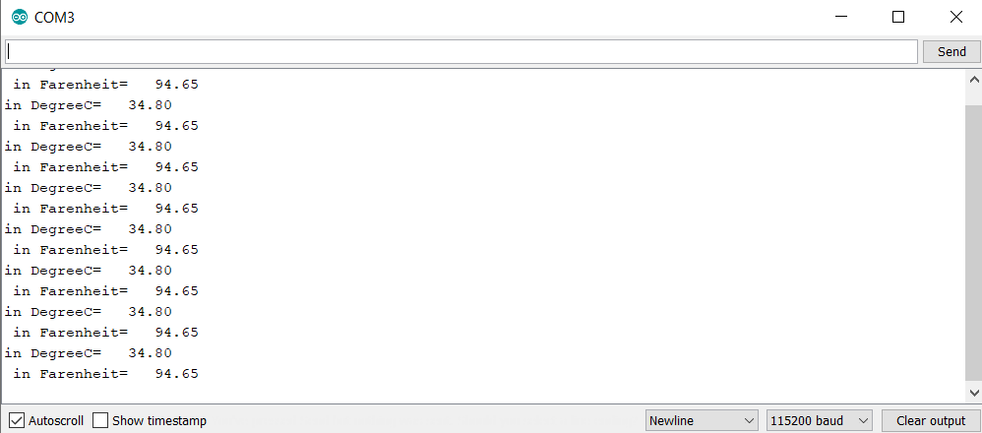
Serial Monitor Displaying Temperature Value

Slide 23
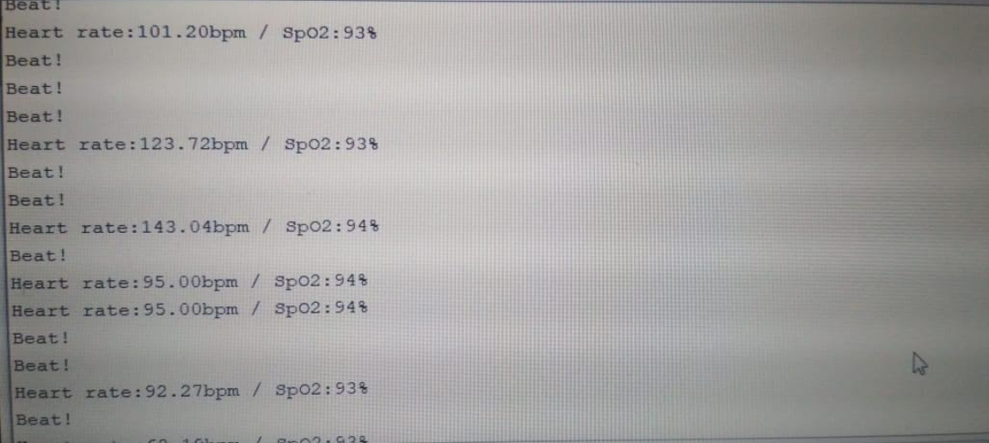
Serial Monitor Displaying HeartBeat and Oxygen Values

Slide 24
7.
REFERENCES

Slide 25
References
https://sci-hub.tw/10.1109/iciiecs.2017.8275903
https://components101.com/microcontrollers/at89s52-microcontroller-pinout-features-datasheet
https://sci-hub.tw/10.1109/scopes.2016.7955637
https://sci-hub.tw/10.1109/csitss.2017.8447861
https://randomnerdtutorials.com/sim900-gsm-gprs-shield-arduino/
https://www.instructables.com/id/IOT-Based-Healthcare-System-for-Elderly/
https://ieeexplore.ieee.org/document/8336583
A Decentralized Privacy-Preserving Healthcare Blockchain for IoT by Ashutosh Dhar Dwivedi , Gautam Srivastava, , Shalini Dhar and Rajani Singh

